Slide 1
ADAR - Assignment 1
Jorge Melo & Xavier Pinho
University of Coimbra
2018/2019

Slide 2
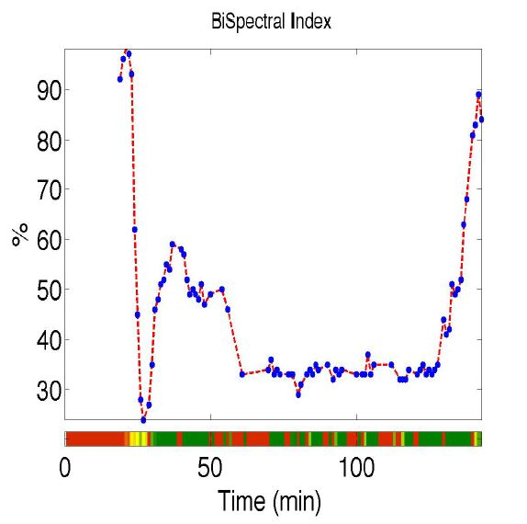
Introduction
Anesthesia monitoring algorithm
EEG (Woman, 50 years, 2:23h)
BISpectral Index (BIS)
BISpectral Index [1]
Notes:
This work’s goal was to try to recreate the BIS algorithm, that tries to predict if a patient in a certain point in time is awake or asleep.
About the BIS: >60 -> awake ; <60 - asleep, however we had a lot of NaN values in our BIS vector.
Data: EEG from a woman (Patient 5) with 50 years during a 2:23h surgery.

Slide 3
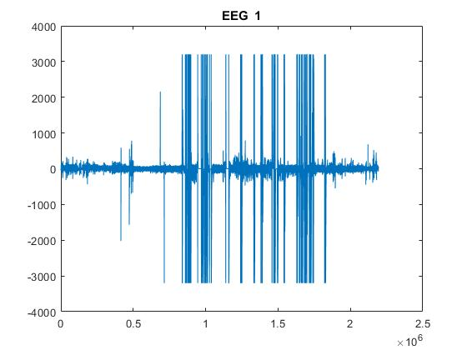
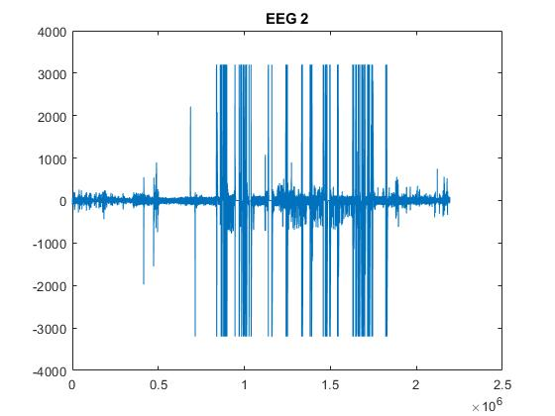
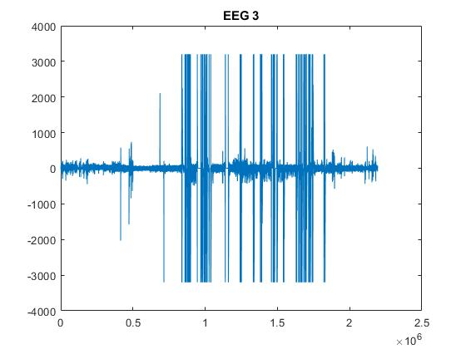
Pre-Processing
9 Electrodes from the scalp region (A & AF)
trc_file.mat
Notes:
We selected the electrodes from the scalp region that were the ones with the labels “A” and “AF”.
Trc_file.mat to read the EEG signal. Some plots of EEG signals.

Slide 4
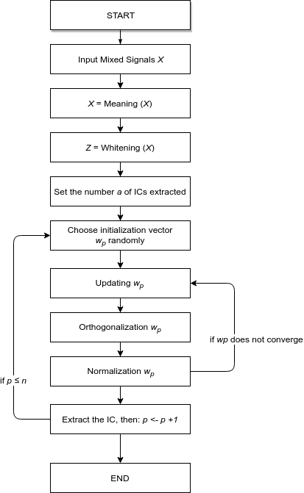
Independent Component Analysis (ICA)
FastICA
Notes:
computational method for separating a multivariate signal into additive subcomponents
ICA finds the independent components by maximizing the statistical independence of the estimated components
Meaning -> whitening

Slide 5
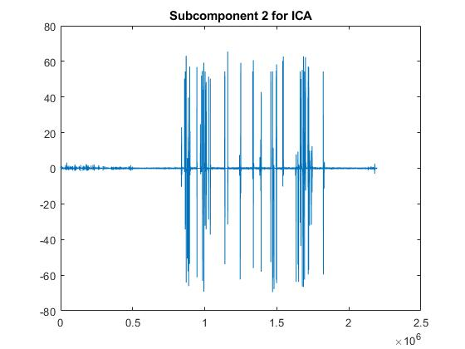
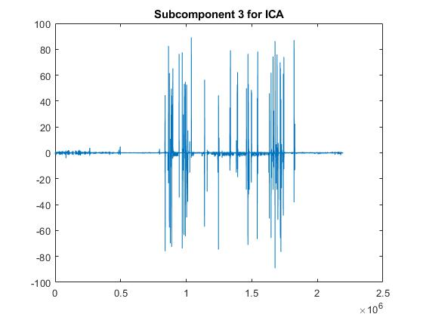
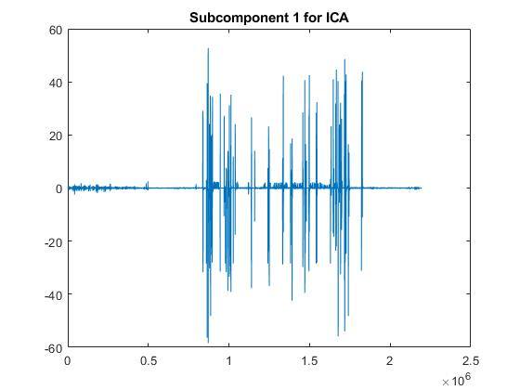
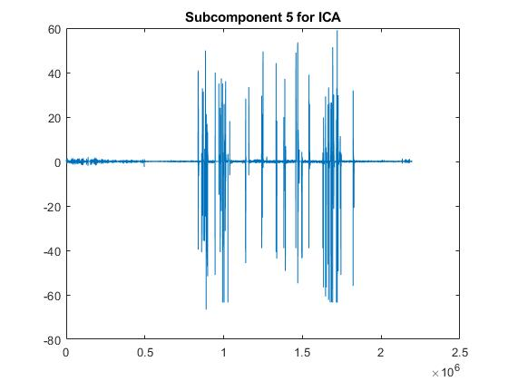
ICA

Slide 6
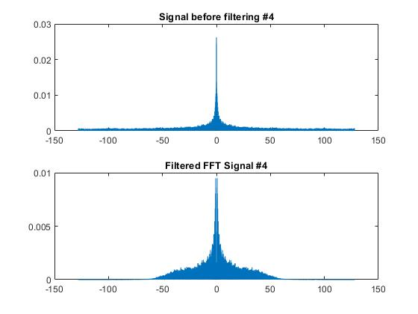
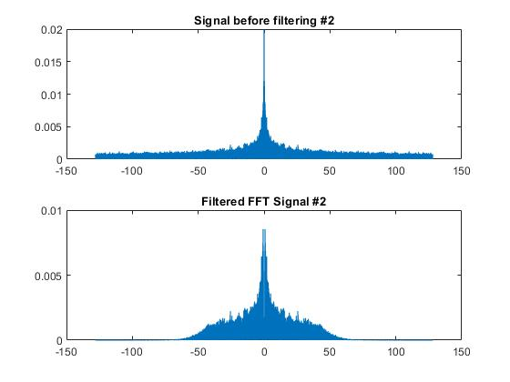
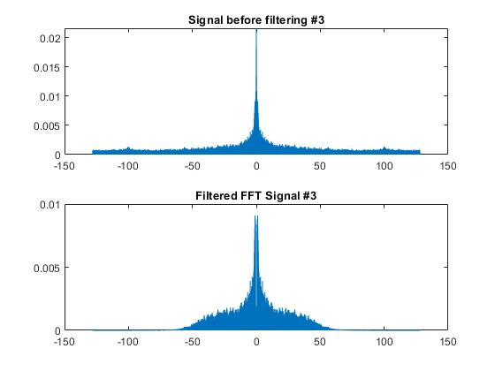
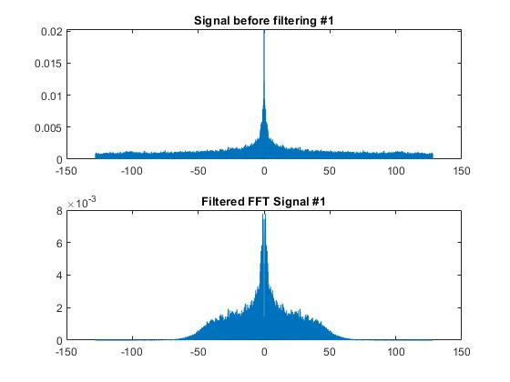
Filtering
(0.5 - 45) Hz
Notes:
We tried several types of filters:
FIR (Finite Impulse Response): - Rectangular - Triangular - Hamming
IIR (Infinite Impulse Response): - Chebyshev - Butterworth
But after plotting the results we decided to use IIR - Chebyshev type filter.
First we tried to use a bandpass but then we used an high pass followed by a low pass filter to get only frequencies between 0.5 and 45 Hz.
We only applied the filters to the ICA signals we selected previously.

Slide 7
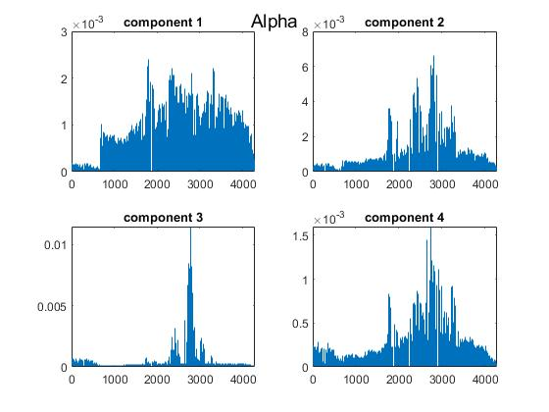
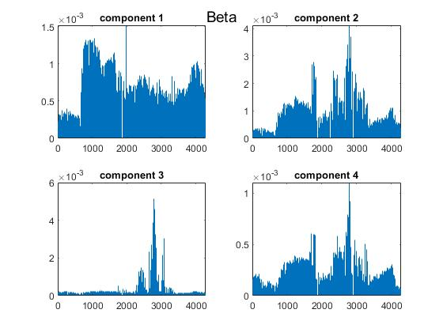
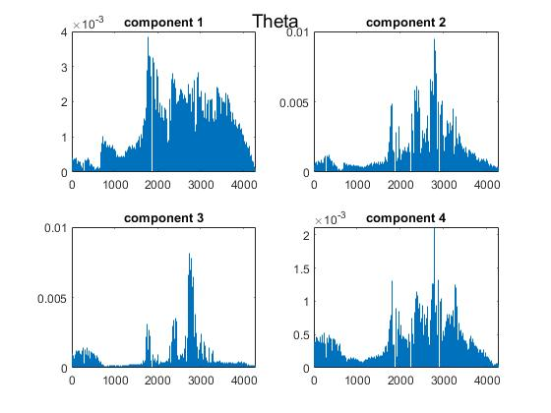
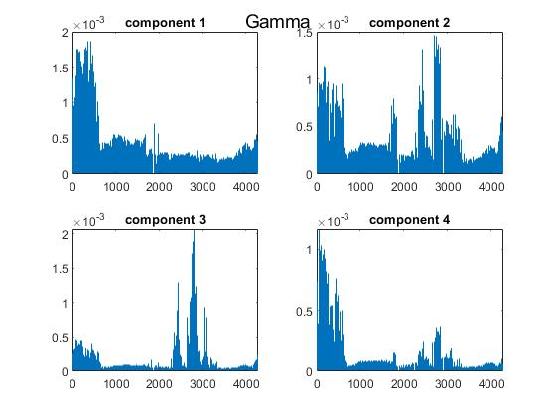
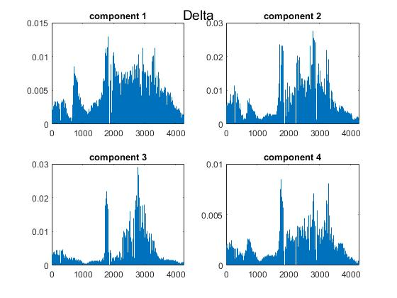
Wavelet
Decomposition
Notes:
discrete wavelet transform (DWT) to decompose the filtered ICA components
Decompose the signals in sub-bands approximately coincident with the standard EEG
frequency bands, i.e.:
• Delta: 0.5-4 Hz
• Theta: 4-7 Hz
• Alpha: 8-12 Hz
• Beta: 12-30 Hz
• Gamma: >30 Hz

Slide 8
Dimensionality Reduction
PCA
MDS
Notes:
In order to visualize the high dimensional data we had to perform 2 techniques of Dimensionality Reduction (MDS - Multidimensional Scalling and PCA - Principal Component Analysis) to 2 or 3 dimensions.
Besides these dimensionality reduction it also reduces eliminate unnecessary information, making the data more significant and less heavy for computing.

Slide 9
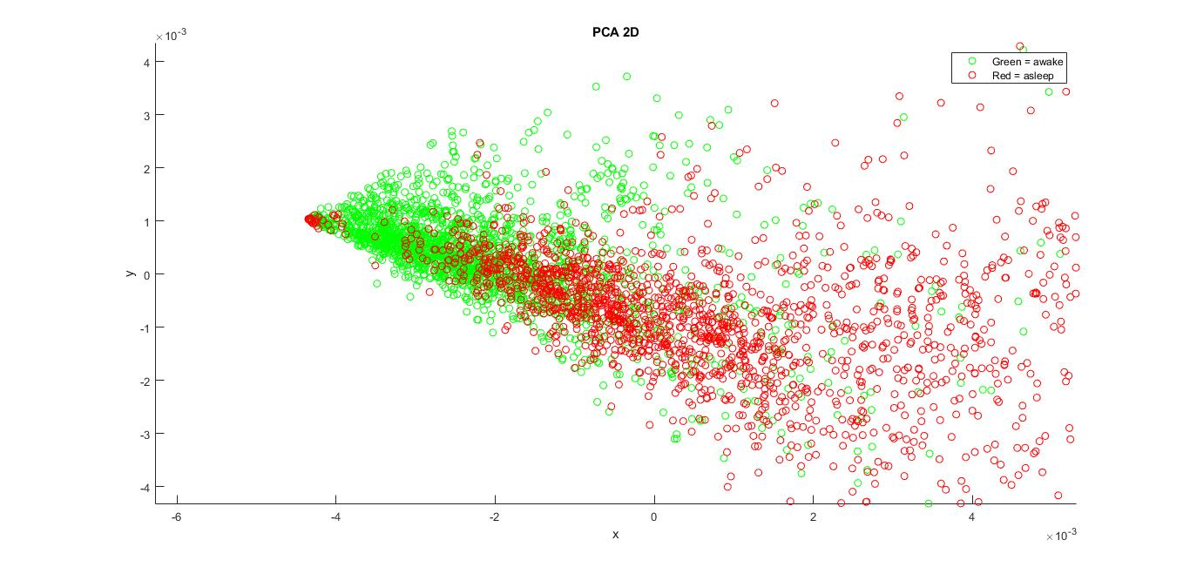
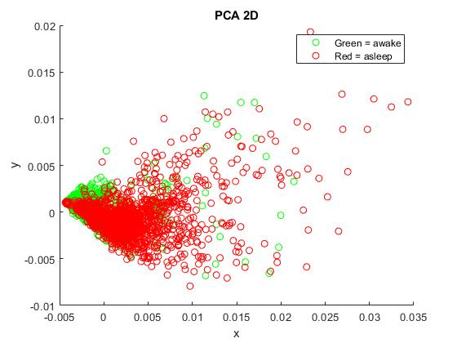
PCA 2D
Notes:
Here we added a label to be more easy to visualize the data where
green -> awake (BIS>60)
red -> asleep (BIS<60)

Slide 10
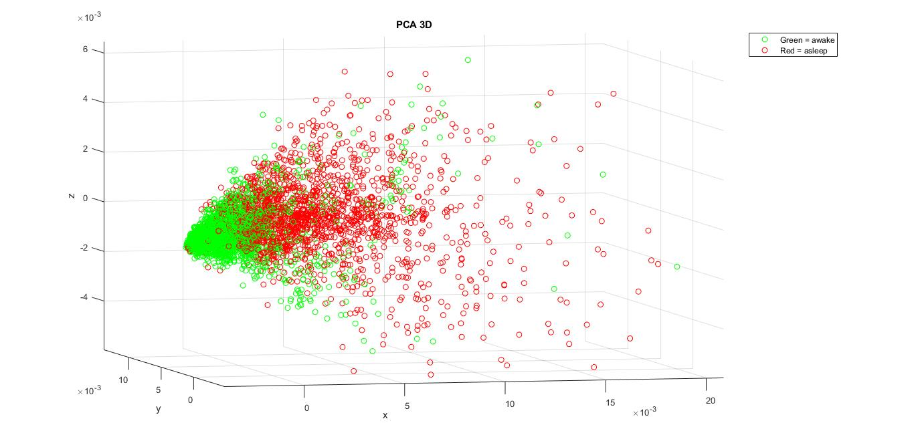
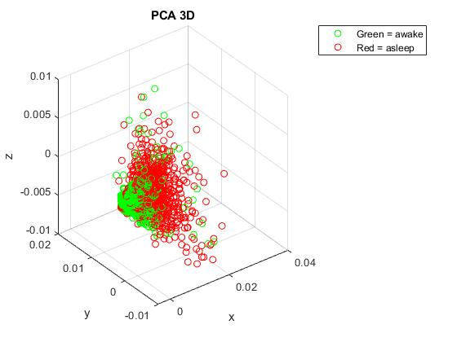
PCA 3D

Slide 11
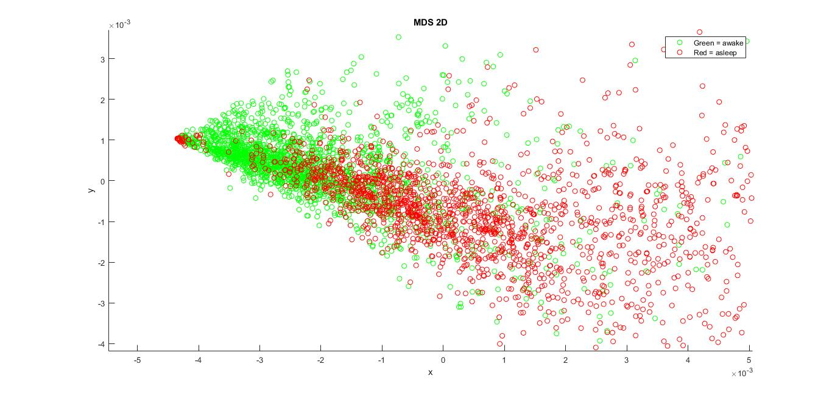

MDS 2D

Slide 12
Clustering
Hierarchical
Partitional
Notes:
• A partitional clustering a simply a division of the set of data objects into non-overlapping subsets (clusters) such that each data object is in exactly one subset.
• A hierarchical clustering is a set of nested clusters that are organized as a tree.

Slide 13
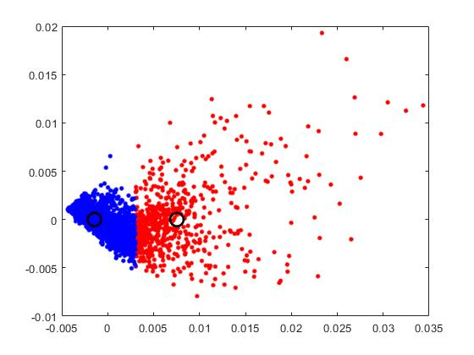
Partitional Clustering
(K-means) with
PCA 2D data
Notes:
Azul dormir

Slide 14
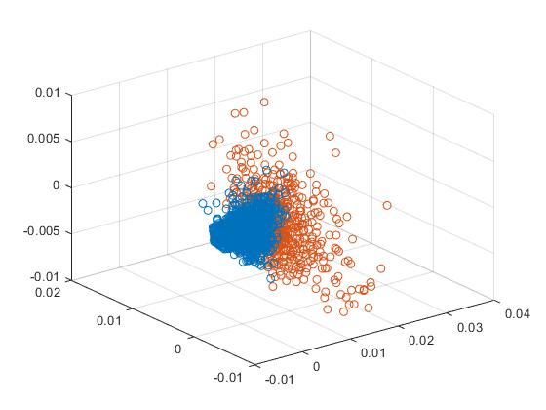
Partitional Clustering
(K-means) with
PCA 3D data
Notes:
Azul dormir

Slide 15
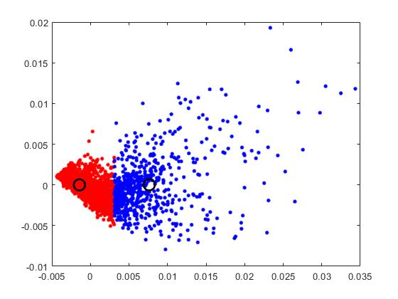
Partitional Clustering
(K-means) with
MDS 2D data
Notes:
Vermelho dormir

Slide 16
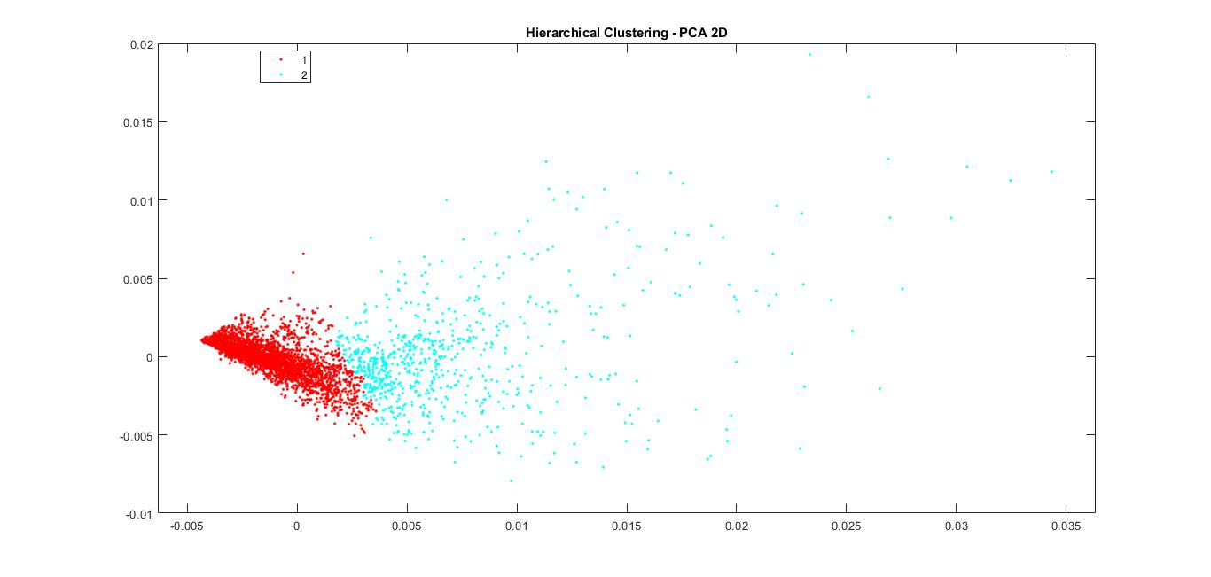
Hierarchical Clustering
with PCA 2D data

Slide 17
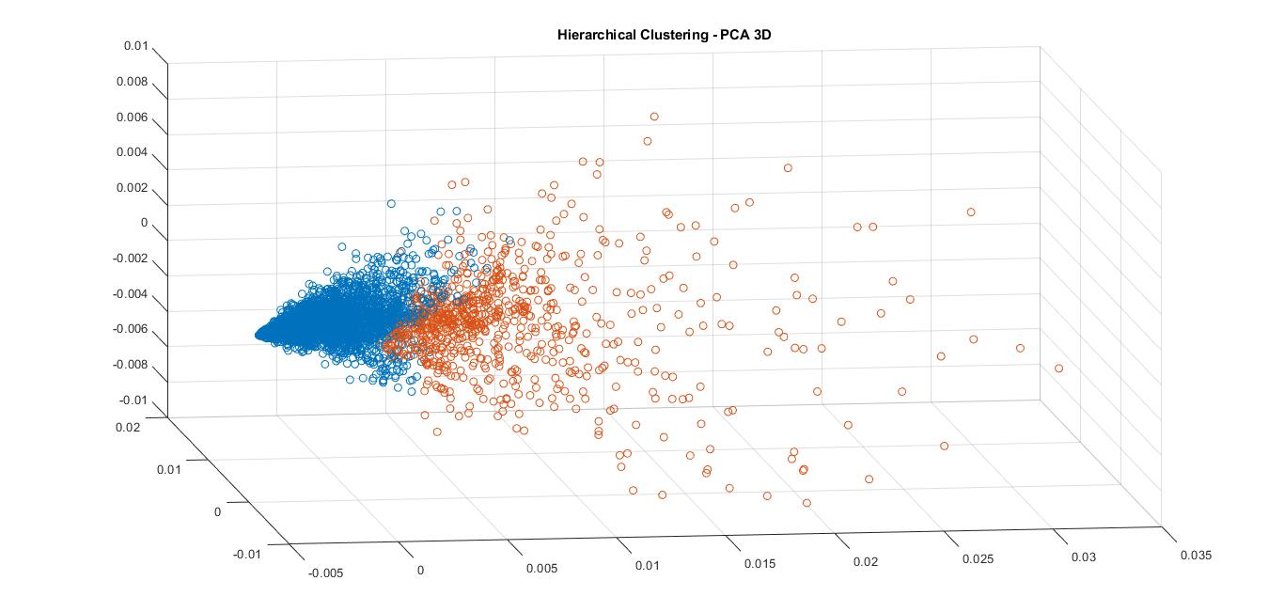
Hierarchical Clustering
with PCA 3D data

Slide 18
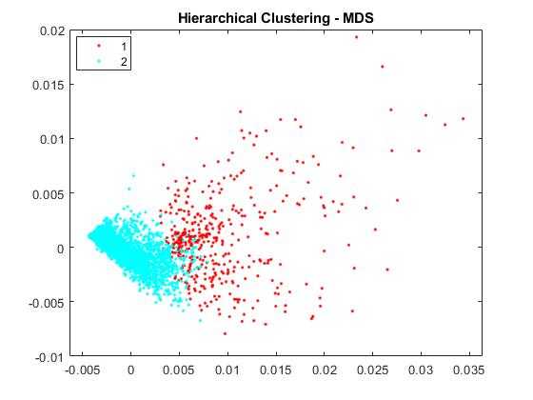
Partitional Clustering
with MDS data

Slide 19
Results
Method | Data | Accuracy | Sensitivity | Specificity
Partitional Clustering (K-means) | PCA 2D | 61 | 28 | 96
 | PCA 3D | 61 | 28 | 96
 | MDS 2D | 60 | 27 | 96
Hierarchical Clustering | PCA 2D | 62 | 30 | 96
 | PCA 3D | 63 | 32 | 96
 | MDS 2D | 57 | 18 | 98
Notes:
The results show the difficulty of classifying a patient state during surgery based on EEG monitoring.
There’s a lot of different noise sources that make it really hard for a algorithm to extract useful information from the data, that's some of the reasons why BIS algorithm is partially unknown. Another reason is the small amount of data that is also unbalanced.
Despite this, we were able to recreate a simple algorithm that mimics the BIS algorithm.

Slide 20
References
All figures were collected from our assignment (2019) ADAR_Assignment1_Jorge_Xavier.pdf , except figure [1];
[1] Correia, A. D. (2019) ADAR2019Assignment1.pdf page 16;
Correira, A. D. (2019) ADARWavelets2019EN.pdf;
Correira, A. D. (2019) ADAR2019ClusteringSlidesEN.pdf.

